Slide 1
Blue Green Deployment, Canary Testing/Deployment, A/B Testing

Slide 2
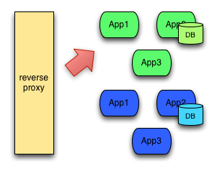
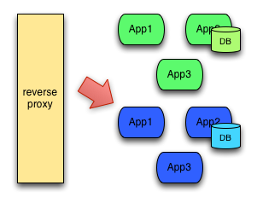
Blue Green Deployment
Blue/Green deployment means creating two identical environments, change the code on one at a time, and switch all the users to the new code. If there's a problem then switch back quickly to the old code base.
Testing of code in identical environment before release in a production reduces chances of problems.

Slide 3
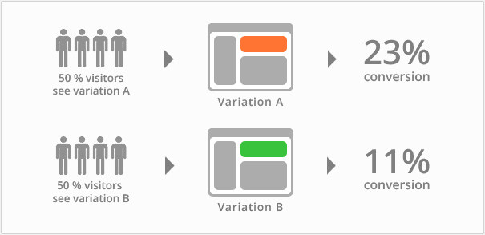
A/B Testing
A/B testing is a situation where two versions of an app or web page get tested at once with the same users and the best is picked to win. Best one is picked up based on lots of metrics and data analytics.

Slide 4
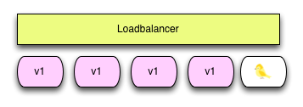
Canary Testing/Deployment
Canary testing is situation where there is no other way of finding out if the code changes work or not, so code is made live with a subset of real users and get feedback.
Eg: Facebook does this with the entire population of New Zealand. After getting feedback from small group of real user related to its performance and integration with other apps, CPU, memory, disk usage, etc., it will be made available for entire population.

Slide 5
When to Use Blue Green and Canary Deployment?
Blue Green Deployment | Canary Release
Blue-green releasing is simpler and faster. | Canary Release is slow and steady approach
Blue-green deployment is done when certainty is very high that the new version will function correctly in production | Canary release is done if certainty is low that the new version will function correctly in production.
Feature toggles is a good way to increase your confidence in a new version to rollback in case of any problem. | Breaking application into small, independent releasable services is good way as Internet is a large and complex place and is always coming up with unexpected challenges.
The essence of blue-green is deploying all at once. | The essence of canary deployment is deploying incrementally
Using different regional data centers, Blue-green deployment can be done within each data center | Using different regional data centers, canary release can be done across data centers

Slide 6
Example
Within PAAS services in Azure, Create two identical Azure Container Services with identical kubernete cluster having 2 windows Agent node and 1 Linux Master node.
Create one Azure Registry pointed by both Azure Container Services.
During CI/CD in .NET Application using VSTS, in release definition toggle the kubernete cluster connection. This implements Blue green deployment
If some part is released in second kubernete cluster and made available to one region of data centre for testing. After its success, same version is made available to first kubernete cluster for whole world then it is Canary release
If there is one more kubernete cluster then different versions are made available to different regions of data centre on second and third kubernete cluster. After success of any one of the version, it will be made available to first kubernete cluster for whole world then it is A/B testing

